Slide 1


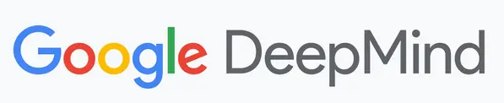
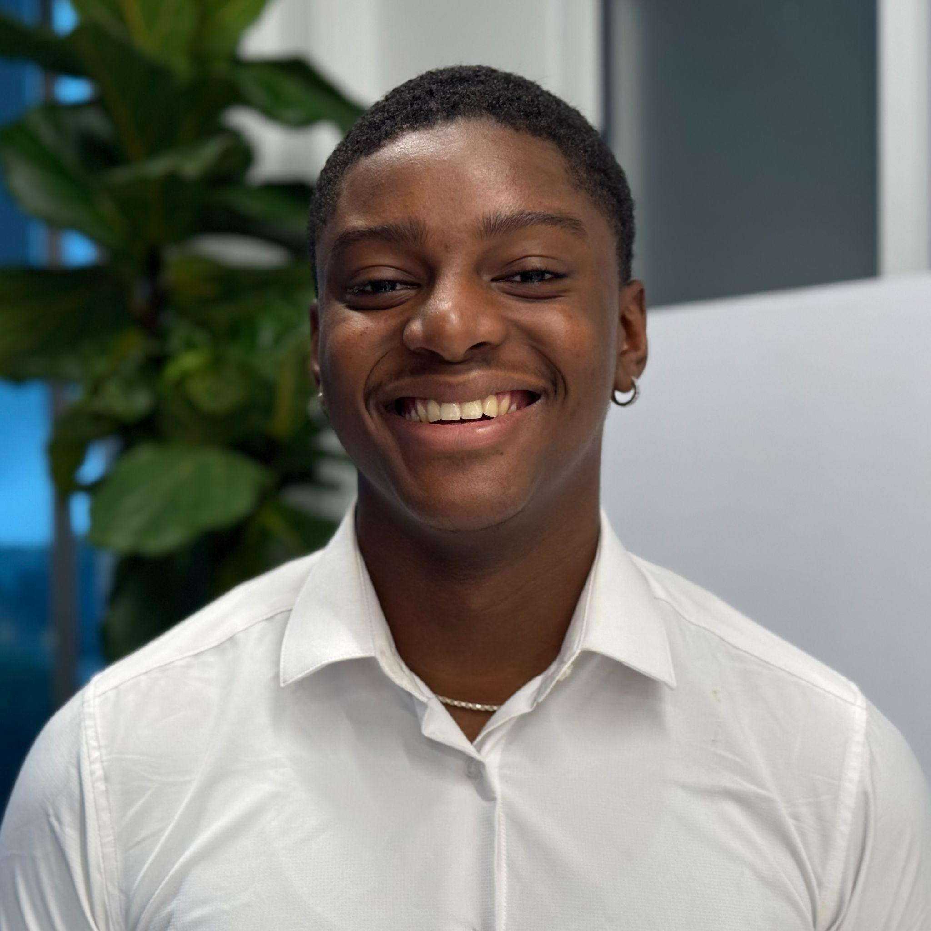


The Fourth Perception Test Challenge
KilometerAudio (Task 3) @ECCV2026
AVRA: An Audio-Visual Reasoning Agent for Long-Form Video QA
Team IUCV
Edred Azziz · Undergraduate | Juhyung (Tony) Ha · Ph.D. student | David J. Crandall · Faculty
Indiana University Bloomington
Notes:
Hello everyone.
My name is Edred Azziz. I am in the 4th year of my undergraduate degree at Indiana University where I am studying Intelligent Systems Engineering.
Alongside engineering, I work in the IU Computer Vision Lab under Professor David Crandall, which is where this work was developed.
The last few days or so have been a real whirlwind for me! We were told on Friday that we won & were being invited to speak & then that following on Monday I found myself on a flight going to Sweden.
I can remember first reading about the Perception Test Challenge & thinking about how cool it would be if we won & had the opportunity to come here. So it’s very gratifying to be here & kinda make those dreams a reality, so to speak.
I’m excited to share our work with all of you & with that, I’ll introduce AVRA, An Audio-Visual Reasoning Agent for Long-Form Video QA, put together by the IU Computer Vision Lab.
This work is co-authored by Tony Ha, *PAUSE* a brilliant 4th year PhD student at IU who deserves his recognition though he couldn’t be here today. & is also supported by David Crandall.

Slide 2
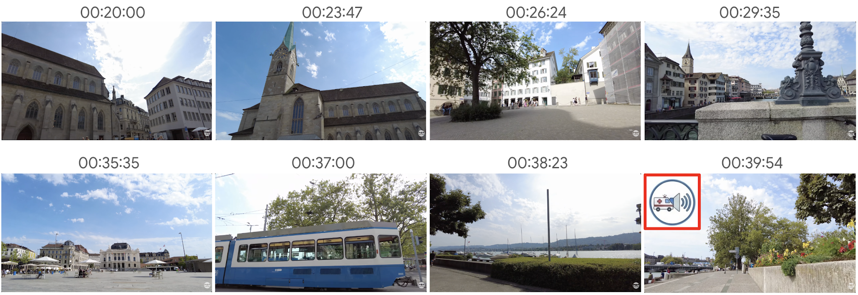
THE FOURTH PERCEPTION TEST CHALLENGE · ECCV 2026
KilometerAudio (Task 3)
218
test videos
~1-hour walking tours
500
test questions
multiple choice
~72 min
avg. video length
unnarrated, real-world
5 · 8
validation videos · questions
with ground truth
Example questions
Q Around what time of the day is there an ambulance heard?
Q How many times did the bell ring, and what was the time of day?
Q In front of Pizza Hut, which instrument is being played?
Temporal localization
Audio–visual linking
Event counting
Duration estimation
Fine-grained recognition
AVRA · Team IUCV · Indiana University Bloomington
ECCV 2026 Perception Test Challenge — 2 / 8
Notes:
We entered task #3 of the Perception Test, called “KilometerAudio”. In this track, we’re given a dataset of hour-long unnarrated walking-tour videos & asked to answer multiple-choice questions about that video.
TAKE A DRINK & A BREATH
One example question might be: “Around what time of the day is there an ambulance heard? “
Whatever solution you find to answer that question requires you to…. SHORT PAUSE… analyze the video, temporally localize the event, then perform some reasoning to answer.
A lot of the questions require multimodal localization of both audio and visual events across video.
After localization, you must THEN perform some model reasoning to answer questions correctly.

Slide 3
AVRA · AUDIO-VISUAL REASONING AGENT
Method Overview
Foundation
Agentic harness AGY (antigravity-cli) with a Gemini 3.7 Flash — High Thinking backend.
Command-line tools + flexible problem-solving strategies for diverse question types.
01
Metadata-based retrieval
Query-agnostic temporal indices (sound events, objects, OCR) replace exhaustive frame search.
Slide 4
02
Loop engineering
Human-in-the-loop workflow search: iteratively refine the harness on the validation set.
Slide 5
The problem
Out of the box, agents under-investigate the video: they answer before gathering evidence, and reasoning is weakly supported.
03
Agentic long-video solver
Option-blind reasoning with checklists and targeted verification at test time.
Slide 6
AVRA · Team IUCV · Indiana University Bloomington
ECCV 2026 Perception Test Challenge — 3 / 8
Notes:
The full test set contains 500 questions across 218 videos.
These questions span many types — identification, counting, duration, timing, and more
Method Overview:
Our approach has three components:
We begin with metadata extraction
Our next step is an “Iterative Workflow Search”
Then lastly, we have an “Agentic long-video Solver” to answer questions

Slide 4
COMPONENT 01
Query-Agnostic Metadata Extraction
The challenge
Early loops burned tokens on exhaustive search: N×N frame grids inspected until a cue appeared.
Sound events — BEATs
447 AudioSet classes at 40 ms resolution
A timeline of what sounds occur, and when
01
Our solution
Precompute structured, query-independent temporal indices over three modalities.
Objects — YOLOE
Open-vocabulary detection, 51 categories at 2 FPS
Class labels, confidence, boxes, timestamps
02
The impact
The solver queries indices first for initial temporal localization — no exhaustive visual search, far fewer tokens, far less time.
On-screen text — PP-OCRv6
Multilingual OCR at 2 FPS
Storefronts, street signs, contextual text
03
AVRA · Team IUCV · Indiana University Bloomington
ECCV 2026 Perception Test Challenge — 4 / 8
Notes:
Meta Extraction
***Speak slower & smarter & more technical & use your hands here***
The first step in our approach is to create indexes that scan our video to catalog what is occurring. We catalog: what sounds are occurring, what objects appear, & what text can be seen.
For sound event detection, we use BEATs, which is an audio tokenizer trained on AudioSet labels, if you know the AudioSet dataset.
We classify these sound events temporally across the full video. This sort of builds a timeline of both WHAT is heard and then also WHEN it’s heard.
For object detection, we use YOLOE, which is an open-vocabulary object detector. We scan through video at 2FPS & record detections of 51 different classes of objects.
And these class cover the typical visual content you'd find in walking-tour footage… pedestrians, vehicles, animals, instruments, that sort of thing."
For on-screen text detection, like storefronts & license plates, we PP-OCRv6, which is an optical character detection model. We again scan through video at 2FPS, recording detections of any visible text in the scene.
An example question may be, “What animal is both seen & heard in front of Malmo Arena?” Our OCR procedure finds the words “Malmo Arena” in the frame. YOLOE recognizes the occurrence of the dog. And lastly, SED logs our dog barking.
These 3 approaches combined give us a rich temporal index about what is occurring & what is seen in video,

Slide 5



COMPONENT 02 · HUMAN-IN-THE-LOOP WORKFLOW SEARCH
Loop Engineering
~50
automated iterations
1
2
3
Draft harness
Run on validation
Audit failures
“Here are the video and the question — solve it.”
Solver agents attempt all 8 questions.
Evaluator agents review traces; humans step in when needed.
3-5
human interventions
Using
5 · 8
validation videos · questions
final workflow
Frozen before touching the test set.
4
Refine the harness
Rewrite instructions, checklists, constraints.
Model weights stay fixed — only the workflow and prompts are optimized.
AVRA · Team IUCV · Indiana University Bloomington
ECCV 2026 Perception Test Challenge — 5 / 8
Notes:
Agentic Solution Loop
Even though we have access to that index, the real difficulty lies in teaching our agents how to use these indexes intelligently.
The questions found in our test set are so diverse that it’s hard to find one general workflow to answer such wide variety.
For the approach we used, I’ll start with sort of a 10k foot view of our agentic workflow search then dive into specifics.
As opposed to hand-crafting a fixed pipeline that can answer ALL question types, we started by building a super bare bones rough draft prompt that our agents can use to answer questions.
Essentially, we just tell our model that it has access to THESE meta files, THIS video, and THIS question.
And then to go Answer your question
Naturally, that first attempt isn't going to perform well — but that's by design. The GOAL is to initially generate failures that we can trace. We want to see where localization went wrong, where things were misinterpreted, or where certain stages were bypassed, etc.
SLOW DOWN
Based on the errors found in our initial responses, we then use an analysis agent to diagnose some of the failures found in that workflow & then specifically revise it to better answer questions.
In the paper, we call our “rough draft” workflow W0. We have Gemini Flash 3.7 answer our full list of validations questions using that W0 workflow. In addition to just answering, it also logs its entire reasoning process throughout. So we’re logging the temporal windows are selected, what’s observed in each window, and generally how it’s deriving its final conclusion.
After all validation questions are answered, the analysis agents THEN compare those results to ground truth & diagnose WHERE the reasoning broke down and WHY the reasoning broke down.
That information allows us to make revisions to the next iteration of our workflow, which we call W1. We repeat this cycle of “solve validation questions, analyze approach taken, & revise” until we arrive at our final workflow W*, which is what we’ll use in the full 500 person test set.
I imagine that there’ll be questions regarding the choice of final workflow… To be transparent, and this is sort of the nature of these challenges, we chose our final W after we ran out of tokens & the deadline crept closer — not because our search had converged. I think that with more time and compute, more iteration would’ve brought further gains.

Slide 6
COMPONENT 03 · TEST-TIME WORKFLOW
Agentic Long-Video Solver
1
Localize
2
Inspect
3
Derive
4
Match?
5
Answer
Query metadata indices for candidate timestamps — options hidden.
Watch and listen around each candidate timestamp.
Form an independent answer before seeing the options.
Reveal options — does the derived answer match one?
YES
Select the matched option.
NO
Options-aware retry
Re-localize using option cues; if still no match, best guess.
✓
Checklist per step
✗
Options concealed
required actions are ticked off, so media inspection can't be skipped.
choices stay hidden until observations are logged, preventing anchoring.
AVRA · Team IUCV · Indiana University Bloomington
ECCV 2026 Perception Test Challenge — 6 / 8
Notes:
Agentic Solver
This brings us to our final agentic solver, which actually answers our questions. For 500 total test questions, we initialize a fresh agent for each, allowing us to run up to 30 agents in parallel. All answering questions at the same time.
First, our solver reads the question without seeing the answer choices.
Slowwwww take a breath
It then uses the metadata indexes to find regions in which our event might occur.
Within those temporal regions, our agent then watches & records what it’s observing.
After all regions are recorded (generally there’s about 3 regions & they’re around 3 minutes combined), our agents then compare the information that's found in our logs to the answer choices to find overlap.
For example, if our question is 'What sport are the children playing?' and the agent logs that it sees 'children kicking a ball back and forth on a grass field,' it then sees the options — A) Soccer, B) Basketball, C) Tennis, then it matches what it observed in that region to Soccer.
Pause
If there's no overlap, then we perform a targeted recheck, but this time with the answer choices visible.
On this second search we’re now aware that our pipeline hasn’t effectively localized the event, so we’re giving it a nudge so to speak to guide a more focused search. If evidence still remains insufficient after this second loop, then our solver just makes a best guess.
I’ll quickly address why we don’t allow our agents to see answer choices for every search:
SLOW DOWN IT IS OKAY THAT YOU ARE OVER TIME
LLMs are probabilistic next-token predictors — if we include words like 'soccer' in the query, the model can anchor on that and bias its observations toward confirming that as opposed to just reasoning independently. By withholding the options on the first pass, we force the solver to find its answer purely from what it’s perceiving (Perception Test) in the media rather than rather than fitting evidence to a specific option.

Slide 7
PERFORMANCE AND STATISTICS
Results
78.2%
>95%
less video watched
~3 min viewed of 72-min videos
3.6
candidate timestamps
avg. selected per question
Top-1 accuracy
2nd place on the leaderboard
CONFIGURATION
~17 min
avg. time per question
σ 22 min · range 2.5–197 min
428k
avg. tokens per session
402k input · 26k output
AGY harness · Gemini 3.7 Flash (High Thinking)
30 agents in parallel over hours
AVRA · Team IUCV · Indiana University Bloomington
ECCV 2026 Perception Test Challenge — 7 / 8
Notes:
Results & Findings
Using the final workflow & Antigravity harness alongside Gemini 3.7 Flash High, we achieved a top-1 accuracy of 78.2% — which placed us 2nd on the leaderboard.
Again, we ran 30 independent agents in parallel over multiple hours to answer all 500 questions.
For videos with an average duration of 72 minutes, the agents selected an average of 3.6 candidate timestamps, which covered about 3 minutes of total video time… on average.
The solver took an average of about 17 minutes per question, with a large standard deviation of 22 minutes.
The shortest solving time was 2.5 minutes, and the longest was 197 minutes.
And then lastly, every session used an average of about 402,000 input tokens and 26,000 output tokens.
==================================

Slide 8
CLOSING
Thank You
Team IUCV
Edred Azziz Undergraduate | eazziz@iu.edu
Juhyung (Tony) Ha Ph.D. student | juhha@iu.edu
David J. Crandall Faculty | djcran@iu.edu
Thank you!
For
Questions
Luddy School of Informatics, Computing, and Engineering — Indiana University Bloomington
Collaborations
Job Opportunity
Open source
AVRA Solver
github.com/juhha/AVRA-Solver
We'd love to hear from you.
Metadata Extractor
github.com/eazziz/AVRA-Metadata-Extractor
AVRA · Team IUCV · Indiana University Bloomington
ECCV 2026 Perception Test Challenge — 8 / 8
Notes:
Closing
SKIP THIS
In terms of limitations, our system is currently bottlenecked to Gemini as the only frontier model with native audio understanding — Claude, ChatGPT, and others simply can't process the audio component that many of these questions require. And our workflow search was constrained by time, not convergence — with more resources, there's room to improve.
I know I’m pressed for time, but quickly on a more personal note — I just want to say how this whole experience has reminded me why I got into research in the first place. A few months ago, this was just a challenge I entered hoping to learn something more about computer vision & hopefully perform well, And now I'm standing here in Sweden, sharing our work at ECCV.
I want to thank Tony Ha again for being a great co-author, I want to thank David Crandall for his guidance & mentorship, I want to thank the challenge organizers for the opportunity, and then I want to thank all of you for your time. I hope you enjoyed, Thank you.

